Slide 1
UARS Facilities Workshop: The SuperDARN Upper Atmosphere Facility
J.M. Ruohoniemi, R.A. Greenwald, and J.B.H. Baker
The Bradley Department of Computer and Electrical Engineering
Virginia Polytechnic Institute and State University (Virginia Tech)
E.R.Talaat and R. J. Barnes
The Johns Hopkins University Applied Physics Laboratory

Slide 2
Changes in the Management of SuperDARN
In early 2008 Mike Ruohoniemi succeeded Ray Greenwald as PI of the SuperDARN Cooperative Agreement; Ray retired from JHU/APL.
A mid-latitude SuperDARN radar was constructed at Blackstone, Virginia as a joint project of JHU/APL, VT, and Leicester University (UK).
After lengthy discussions, Virginia Tech and JHU/APL agreed that the Cooperative Agreement would transfer to Virginia Tech with provision to continue activities in support of SuperDARN at JHU/APL.

Slide 3
Changes in the Management of SuperDARN
Mike Ruohoniemi and Jo Baker were appointed to the academic faculty of Virginia Tech while Ray Greenwald has an adjunct research position.
Elsayed Talaat is now the science lead at JHU/APL while Robin Barnes remains as SuperDARN programmer.
Virginia Tech is now the lead institution for the SuperDARN Upper Atmosphere Facility.
Facility operations will be performed jointly by Virginia Tech and JHU/APL.

Slide 4
SuperDARN HF Radar at Goose Bay, Labrador
Radar field-of-view
View of the log-periodic antennas

Slide 5
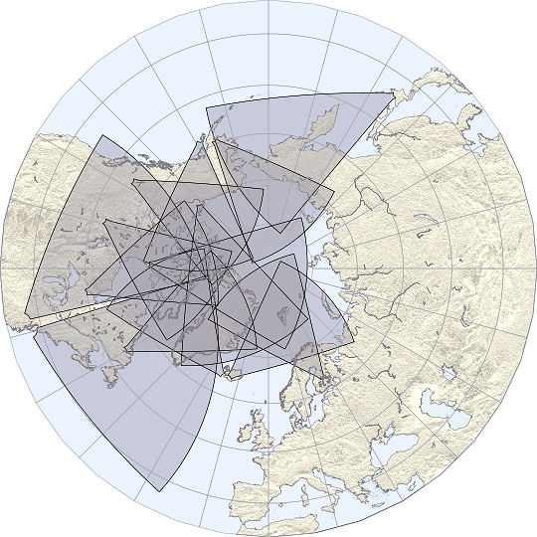
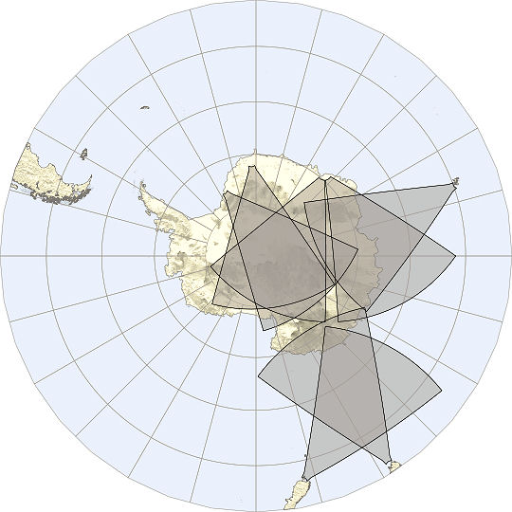
Super Dual Auroral Radar Network
Northern hemisphere
Southern hemisphere
14 radars
7 radars

Slide 6
The SuperDARN Upper Atmosphere Facility
Tasks we perform for the SuperDARN Facility:
maintain operation of the Goose Bay, Kapuskasing, Wallops Island and Blackstone radars
maintain and develop core radar operating and analysis software
merge the data from all the northern radars
support the U.S. community in accessing SuperDARN data and data products
pursue research in magnetospheric, ionospheric, and thermospheric physics.
Collaboration with our SuperDARN partners is an essential aspect of our activities. Relations are maintained via emails, visits, working groups, shared research projects, and an annual SuperDARN meeting that is moved around amongst the participating countries.

Slide 7
SuperDARN PI Institutions
Johns Hopkins University Applied Physics Laboratory (1983)
British Antarctic Survey (1988)
University of Saskatchewan, Canada (1993)
National Center for Scientific Research, France (1994)
National Institute for Polar Research, Japan (1995)
University of Leicester, England (1995)
University of KwaZulu-Natal, South Africa (1997)
University of Alaska (2000)
Communications Research Laboratory, Japan (2001)
La Trobe University, Australia (2001)
Nagoya University, Japan (2006)
Virginia Tech (2008)

Slide 8
Super Dual Auroral Radar Network
Northern Hemisphere
Networks of high latitude HF radars have been built in both the northern and southern hemispheres.
In the north recent construction has taken place at polar and mid-latitudes.
There are important synergies with the existing UAF incoherent scatter radar facilities and with the AMISR project.
Combining observations from all the radars gives a global-scale view.
Hokkaido
PolarDARN
Blackstone
Wallops

Slide 9
The SuperDARN Collaboration
The SuperDARN Cooperative Agreement funds the operation of four of the radars. The U.S. research community thereby gains access to the entire SuperDARN database.
The radars are operated with common operating software.
The data are produced in common formats .
Much of the radar operating equipment has been developed jointly and can be shared between sites.
The radars operate continuously and follow a common schedule.
Innovations in software and hardware can be easily shared between the collaborating institutions.
The activities of the collaboration are coordinated by working groups with oversight from a PI committee.
An annual meeting provides a forum to review operations, make plans, and present research findings.

Slide 10
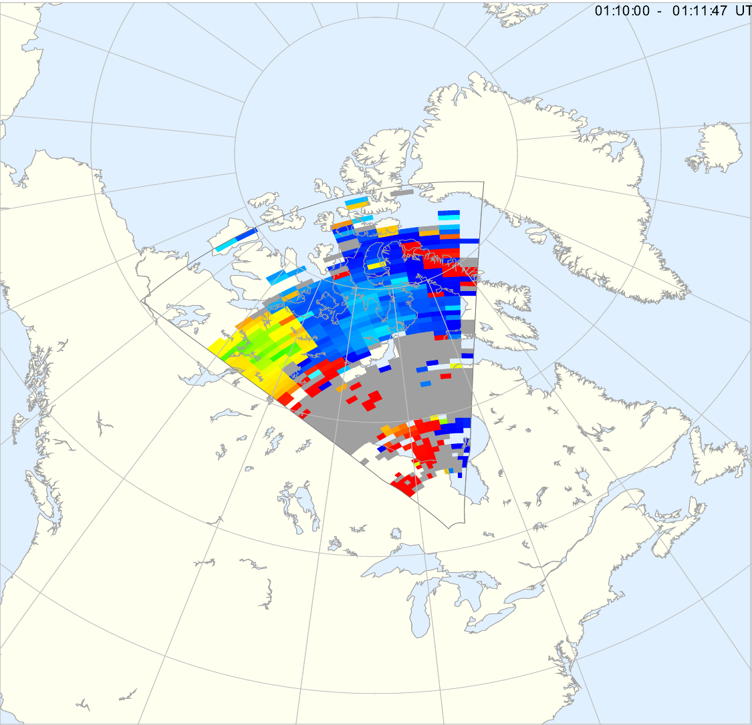
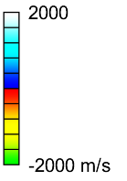
Map of Doppler Velocity Obtained with a SuperDARN radar
January 11, 2001 01:10:00 – 01:11:47 UT
Kapuskasing, Ontario

Slide 11
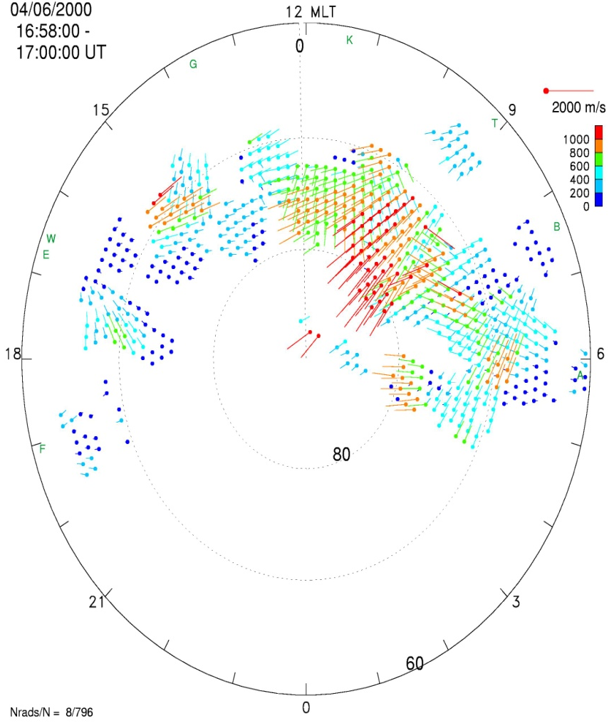
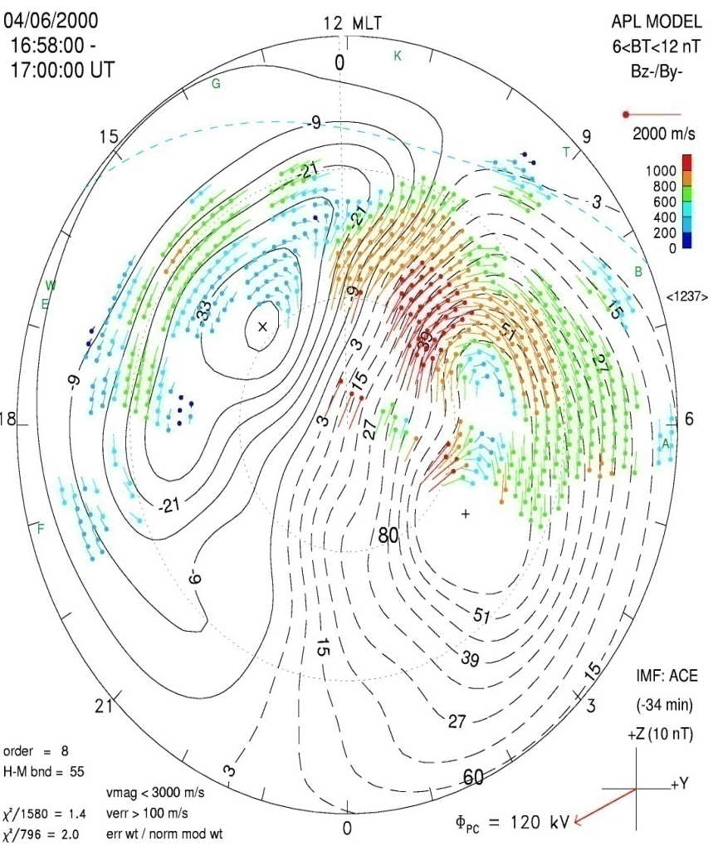
SuperDARN:
Mapping the global convection pattern
Line-of-sight velocities
Fitted potential pattern
[Ruohoniemi and Baker, 1998]

Slide 12
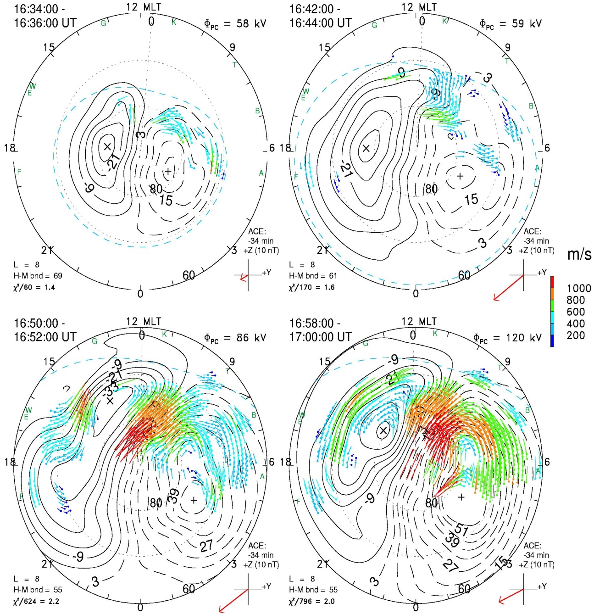
Space Weather
Mapping the response of the high-latitude ionosphere to the CME of April 6, 2000
[Ruohoniemi et al., 2001]

Slide 13
Time series of SAPS velocity observed with the Wallops SuperDARN radar

Slide 14
SuperDARN data products
The radars produce observations of
Ionospheric plasma drifts and convection electric field
Irregularity occurrence
TIDs and atmospheric gravity waves
Mesospheric neutral winds
PMSEs
??
The most requested product are the maps of the global convection pattern and related measurements.

Slide 15
Distribution of data as a facility
At one point we attempted to respond to data request on an individual basis, we were soon overwhelmed.
A very large effort has gone into distributing data by web site. The SuperDARN web site maintained by JHU/APL provides
Direct links to the screens of the radars with real-time internet links
Real-time convection maps
Archived convection maps and access to velocity data
Look-up plots of radar data
Archives of data analysis software
Tutorials on the radar hardware and software

Slide 16
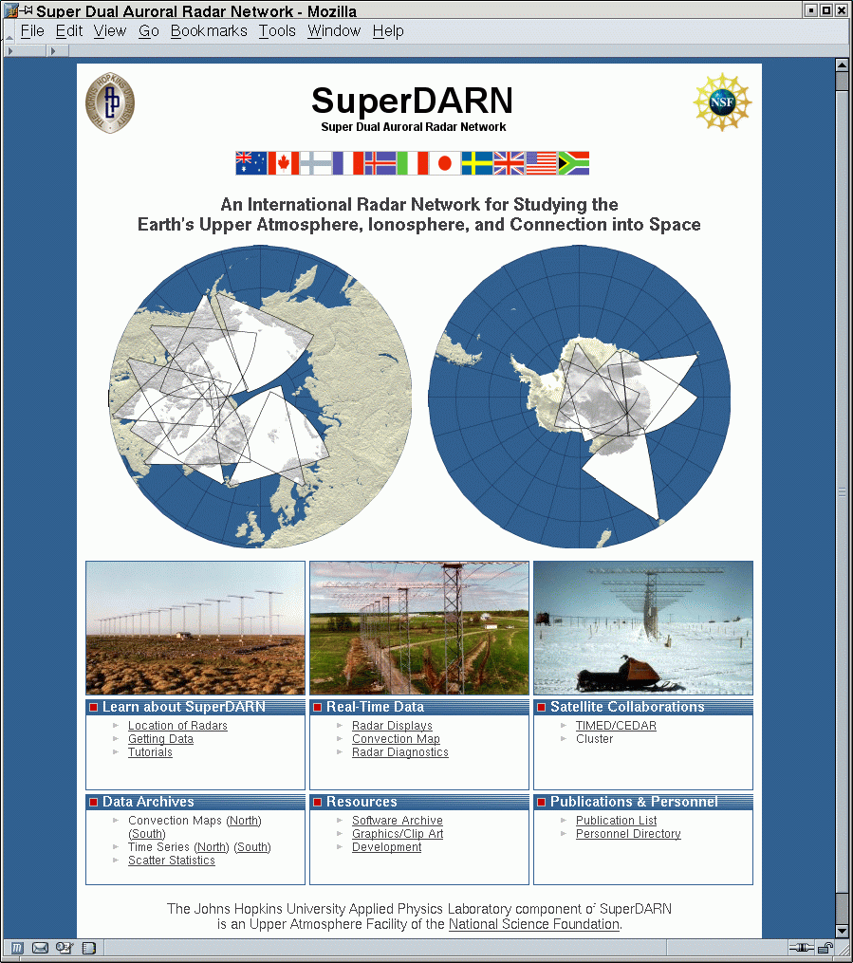
Providing Access to SuperDARN Data Products
All SuperDARN data for both hemispheres are available through the JHU/APL SuperDARN webpage:
http://superdarn.jhuapl.edu
Registered users can download:
Plots
Data files
Plotting software
There are also real-time displays for the northern hemisphere radars.

Slide 17
SuperDARN: Community Support
For many specialized applications of the data we continue to provide individual support.
Advances in data processing and storage capabilities are leading to new products that we can make available but there is strain on our capacities to manage the data flow.
Estimates of web usage, plots downloaded, data transferred….(from Rob)

Slide 18
The SuperDARN Facility: Budget Realities
The SuperDARN facility is funded at a comparatively modest level (~$650k/yr).
Most of the funding goes towards maintaining the radars, data processing, and community support.
Funding for research, while limited, is important for developing new topics.
The SuperDARN facility scientists seek the bulk of their research funding through the competitive grant process.

Slide 19
The SuperDARN Facility: Personnel Realities
While a programmer is funded almost full-time by the Facilities grant, the absence of an engineer means that the scientists themselves must handle the bulk of the technical issues.
It is challenging to simultaneously perform high-level research, manage the facility, personally attend to requests for data and analysis support, and service the radars.
The move to Virginia Tech was motivated in part by these realities – we hope that engaging students at this major teaching institution will expand the labor pool for the SuperDARN facility while increasing the scope of education, training and outreach performed with SuperDARN.

