Slide 1
UARS Facilities Workshop: The SuperDARN Collaboration
J.M. Ruohoniemi, R.A. Greenwald, and J.B.H. Baker
The Bradley Department of Computer and Electrical Engineering
Virginia Polytechnic Institute and State University (Virginia Tech)
E.R.Talaat and R. J. Barnes
The Johns Hopkins University Applied Physics Laboratory

Slide 2
The SuperDARN model
The Super Dual Auroral Radar Network is often held up as a model of scientific collaboration.
SuperDARN was conceived as a system of radars built by individual institutions and sharing a common purpose.
How does the collaboration operate, what are the benefits, and what aspects are applicable to other consortia?

Slide 3
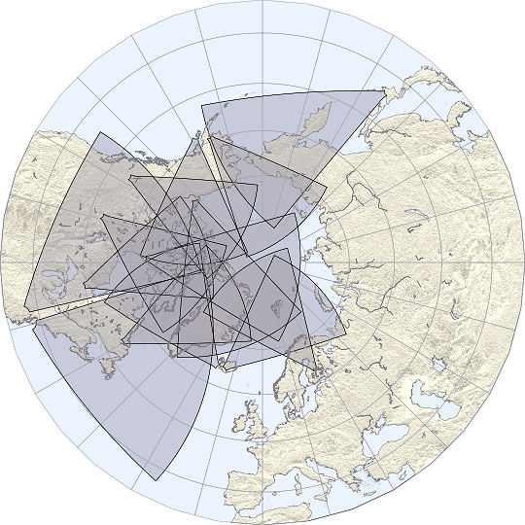
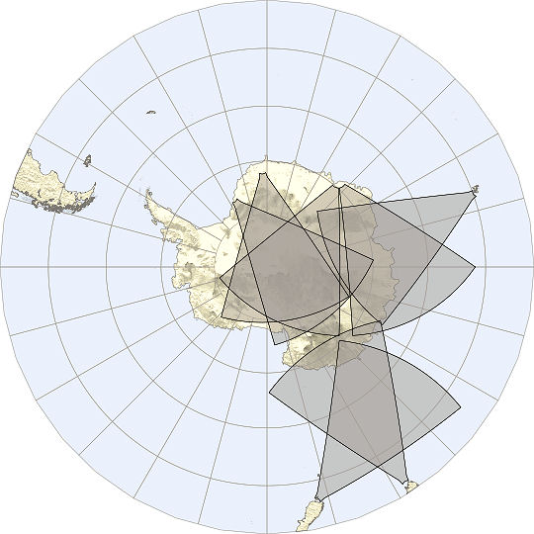
SuperDARN PI Institutions
Johns Hopkins University Applied Physics Laboratory (1983)
British Antarctic Survey (1988)
University of Saskatchewan, Canada (1993)
National Center for Scientific Research, France (1994)
National Institute for Polar Research, Japan (1995)
University of Leicester, England (1995)
University of KwaZulu-Natal, South Africa (1997)
University of Alaska (2000)
Communications Research Laboratory, Japan (2001)
La Trobe University, Australia (2001)
Nagoya University, Japan (2006)
Virginia Tech (2008)

Slide 4
Practical Requirements of the Collaboration
Flexibility
The groups have to respond to the demands of their funding agencies and host institutions
There is no attempt to direct the science programs of the participants
Cooperation
The groups agree to abide by the terms of the PI agreement, which sets standards for scheduling the radars, operating modes, data distribution
Good will
There needs to be a spirit of cooperation. With SuperDARN, this is buttressed by a sense of strong mutual benefit.

Slide 5
HF Radar at Goose Bay, Labrador (since 1983)
Radar field-of-view
View of the log-periodic antennas

Slide 6
The Collaboration: A Brief History
The first radar at Goose Bay defined many of the attributes of the SuperDARN radar.
The group at JHU/APL wrote operating code and data processing software that evolved into the SuperDARN standard.
Collaboration began early with U.K.-U.S. build of the HF radar at Halley Bay, Antarctica (1988). This demonstrated:
The benefits of cooperation for enhancing research
The benefits of leveraging
Recognition of the benefits of cooperation lead to the founding of SuperDARN as a consortium of seven groups involving six countries.

Slide 7
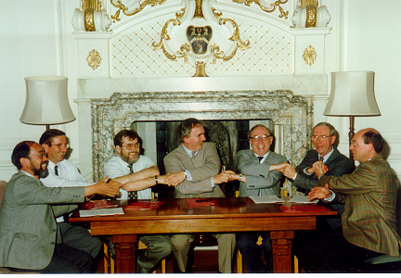
Signing of the international MoU
Madingley Hall (1991)

Slide 8
The SuperDARN Collaboration
The PI agreement
forms the basis for coordination of the operation of the radars, the exchange of data, the analysis and publication of results and the sharing of technical developments
welcomes as a PI a representative of a scientific group that has been responsible for the procurement of principal funding and support in the development of one or more SuperDARN radars
The PI agreement lays out the working of the collaboration in terms of
Operations and scheduling
Data fusion and exchange
Data usage

Slide 9
Levels within the Collaboration
A PI committee oversees the collaboration
current chairman: Prof. Mark Lester (Leicester University)
Working groups are empanelled to manage common tasks. These include:
Scheduling
Radar operating software
Data processing
Data distribution
Satellite coordination
Researchers within individual groups pursue science objectives and technical enhancements

Slide 10
SuperDARN
Relations are maintained via
emails and mailing lists
visits
the working groups
shared research projects
an annual SuperDARN meeting.

Slide 11
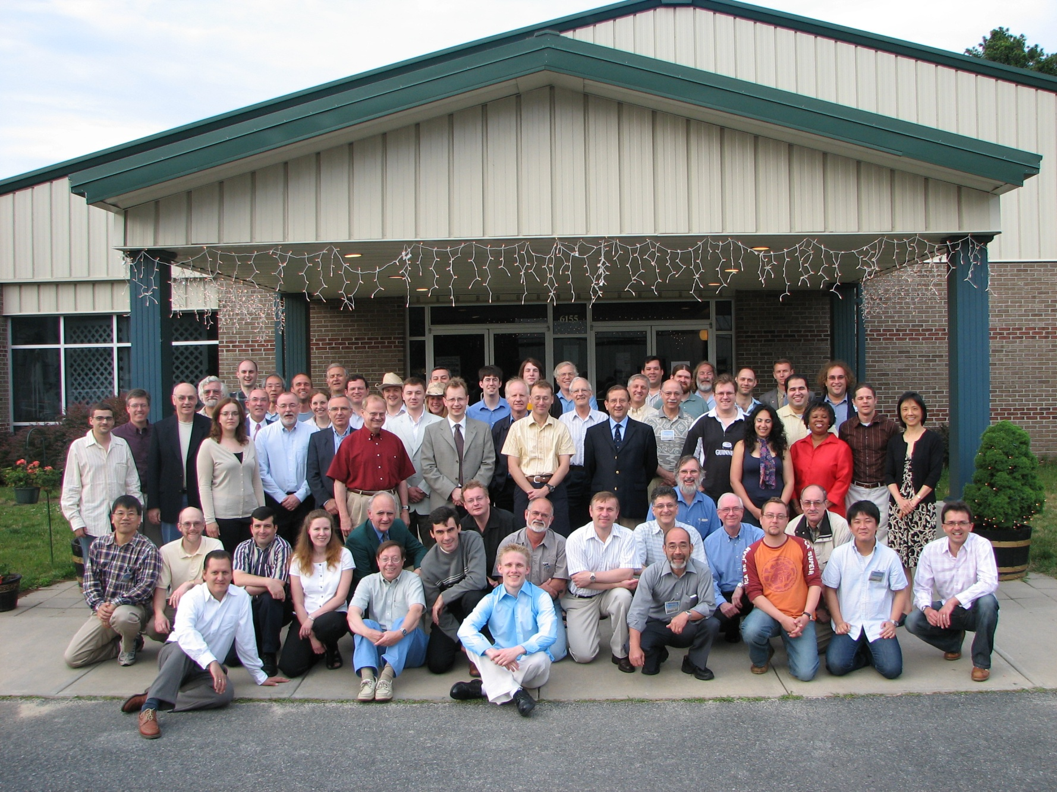
SuperDARN Meeting 2006 Chincoteague, Virginia

Slide 12
Super Dual Auroral Radar Network
Northern Hemisphere
What is the impetus for cooperation?
The obvious benefits to working together!
Hokkaido
PolarDARN
Blackstone
Wallops

Slide 13
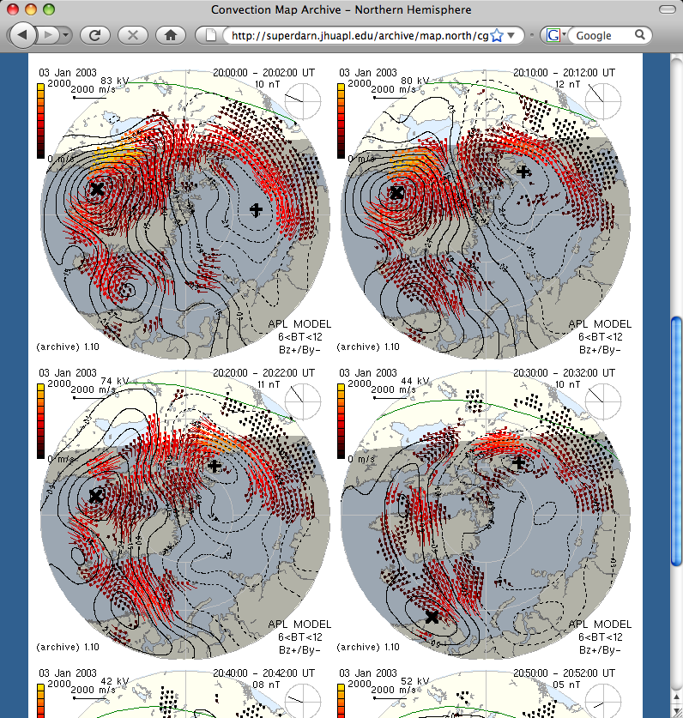
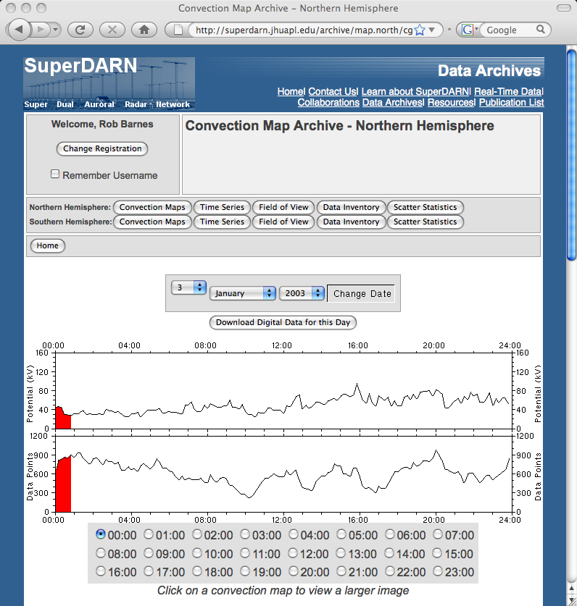
SuperDARN Web Site
Global Convection Maps
1997-Present
10 Minute cadence

Slide 14
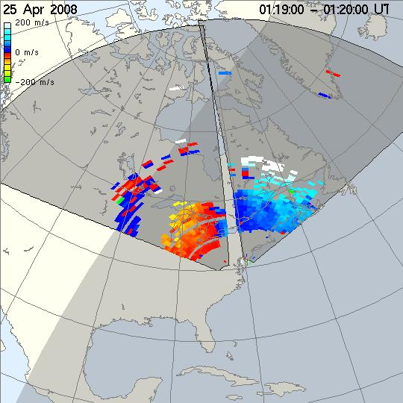
Blackstone/Wallops View of Plasma Flow Bursts Across North America

Slide 15
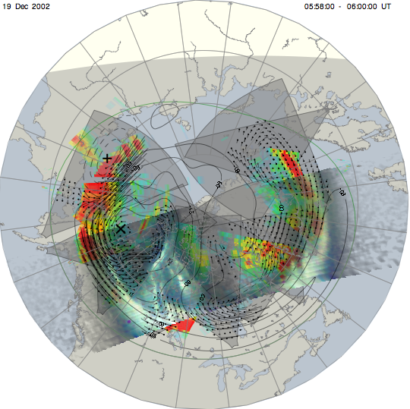
Software Development
Analysis Tools
Multiple data sets can be combined and plotted.

Slide 16
Benefits of the Collaboration
Engagement in a highly visible international scientific enterprise with many leveraging benefits
Access to the entire SuperDARN dataset, operating software, analysis software, etc.
Sharing of technical innovations
Sharing of expertise
Enhanced prospects for scientific collaboration
Access to students and junior researchers
Ease of movement of people between groups
Support of partners when difficulties arise

Slide 17
The SuperDARN Upper Atmosphere Facility within the SuperDARN Collaboration
The Superdarn UAF has ‘pride of place’ within the collaboration.
The relocation to Virginia Tech is making possible an expanded student program within the U.S.
The collaboration now includes having two U.S.institutions, Virginia Tech and JHU/APL, work cooperatively.

